Slide 1
TCP/IP Model
TCP/IP forms the base of present day internet.
TCP and IP are two protocols of this model.
This model was initially used by ARPANET.
The TCP/IP protocol suite was defined as having four layers:
Host-to-network
Internet
Transport
Application

Slide 2
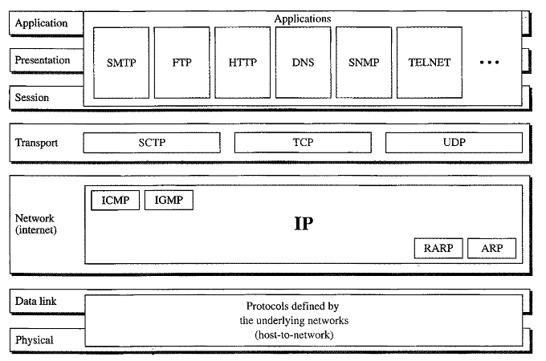
TCP/IP and OSI Model

Slide 3
Host to Network Layer
It is the bottom layer of TCP/IP model also known as Network interface layer.
The purpose of this layer is to connect the host to the network.

Slide 4
Internet Layer
Internet layer is similar to network layer of OSI model in functionality.
This layer is responsible for delivering IP packets to their destinations.
An important protocol of this layer is IP(Internet Protocol).

Slide 5
Internet Protocol(IP)
It is an unreliable and connectionless protocol.
IP transports data in packets called datagrams.
IP does not keep track of the routes.

Slide 6
Transport Layer
Transport layer is similar in functionality to transport layer of OSI model.
Transport layer of TCP/IP model also provides connection oriented and connectionless services.
Connection Oriented – TCP(Transmission Control Protocol)
Connection Less – UDP(User Datagram Protocol)

Slide 7
1) TCP
Transport layer used TCP for reliable connection oriented service.
The various functions of TCP are:
Error Control
Flow Control
Sequencing

Slide 8
2)UDP
Transport layer used this protocol for unreliable connectionless service.
No assurance that packet reached.
No sequencing & No error checking
Useful in real time data transfer and quick transfer of large data.
It follows that delivery is more important than accurate delivery.

Slide 9
Application Layer
This layer is the combination of Application, Presentation and Session layer of the OSI model.
This layer provides various services to different user applications.

Slide 10
Application Layer
Application layer includes several high-level protocols that are used for wide variety of applications like:
TELNET(Terminal Network): Used for remote login.
FTP(File Transfer Protocol): For transfer of file from one system to another.
HTTP(Hyper Text Transfer Protocol): For fetching web pages on world wide web.

Slide 11
Similarities between OSI & TCP/IP
Both are based on the concept of a stack of independent protocols.
Functionality of layers is roughly similar.
Up to Transport – network oriented.
Above – User oriented

Slide 12
Differences between OSI & TCP/IP:
OSI model has seven layers.
TCP/IP has four layers.
OSI model provides clear distinction between services, interfaces and protocols.
TCP/IP doesn’t provide clearly distinguish between services, Interfaces and protocols.
In OSI model transport layer is connection oriented.
In TCP/IP transport layer is both connection oriented and connectionless.

Slide 13
Cntd…
In OSI Data Link layer and Physical layer are separate layers.
In TCP Data Link layer and Physical layer are combined as one in Host-to-Network layer.
Protocols do not fit well into the OSI model.
Protocols fit well in TC/IP model.

